Slide 1
IMDB MOVIE aNALYSIS
BY Sonali Gupta

Slide 2
Project Description
To investigate what factors influence the success of a movie on IMDB?
The impact of this problem is significant for movie producers, directors, and investors who want to understand what makes a movie successful to make informed decisions in their future projects.
The insights provided by a data analyst should provide actionable insights that can help stakeholders make informed decisions.

Slide 3

Tech-Stack Used
To complete this project, I am using MS Excel 2021 as the given dataset is small in size and it is an excellent analysis tool to analyze small size datasets.
It can also be used for data visualization and drawing insights from it.
Also, I will be using MS Power Point and MS Word to form a report.

Slide 4
Approach
First, I will clean the dataset by removing missing values, checking for outliers, removing duplicates, deleting any columns which are not required for analysis, converting data types if necessary in the dataset.
Now, I will summarize my findings by calculating averages, medians, or other statistical measures. It also involves looking for the correlation between movie ratings and other factors like genre, director, budget, etc.
Also, I will be going to perform RCA (root cause analysis) by using the Five 'Whys' Approach to solve the problem and provide various insights.

Slide 5
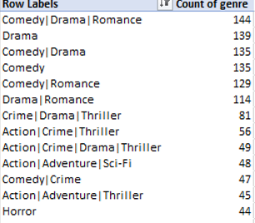
1. distribution of movie genres and their impact on the IMDB score
After cleaning the dataset, the dataset contains 3843 rows in total. Below is the list of top 20 movie genres along with their count:

Slide 6
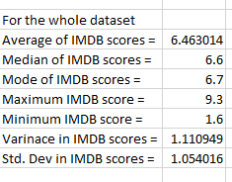
The descriptive analysis of the IMDB scores helps to understand the impact of genre on movie ratings on IMDB platform.

Slide 7
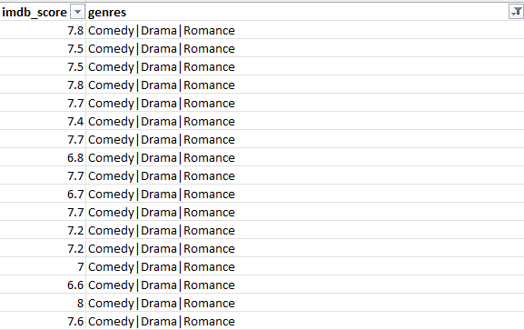
Insight Gained:
Based on the dataset provided, it has been found that Comedy | Drama | Romance Genre is the most popular genre of all the other genres.
After performing the analysis, it has been found that IMDB ratings for each movie with popular genre is not high which means that high IMDB ratings of a movie doesn’t depend on the movie belonging to the category of popular genres.

Slide 8
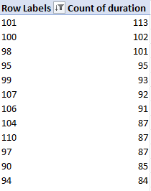
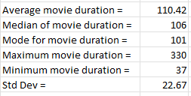
2. The distribution of movie durations and its impact on the IMDB score
Here is the list of top 20 movie durations along with the scatter plot that shows the relationship between the IMDB scores and movie durations.

Slide 9
Insight Gained:
From the scatterplot plotted between movie duration and IMDB scores for top 20 movie durations, it has been observed that for the movies with highest duration, the IMDB score is not the highest. So, this shows that IMBD ratings doesn’t depend on the durations of a movie.

Slide 10
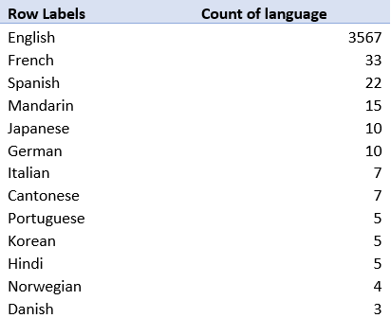

3. The distribution of movies based on their language
Below is the list of movies based on their languages and descriptive analysis of movie durations

Slide 11
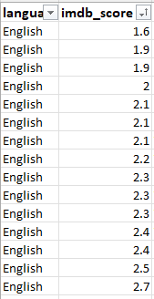
Graphical Representation of Movie LANGUAGES AND IMDB SCORE RELATIONSHIP:
Insight Gained:
From the above scatterplot plotted between language and IMDB scores of different movies shows that IMDB score is not dependent on the languages of the movie.

Slide 12
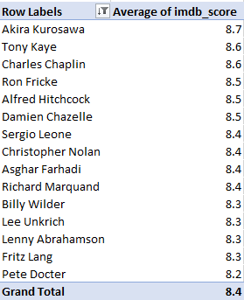
4. Influence of directors on movie ratings
Here is the pivot table showing the list of top 15 directors with their average IMDB scores.

Slide 13
Insight Gained:
As we know that the maximum IMDB score is 9.3 but the average IMDB score for the popular director is 8.7. So, its clear that IMDB ratings of a movie do not depend upon the popularity of the director of the movie.

Slide 14
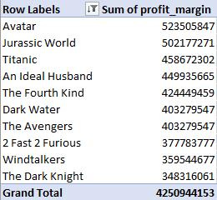

5. The relationship between movie budgets and their financial success
This is the pivot table showing the list of top 10 movies which has the highest profit margins and the calculated correlation between gross and budgets through correl function in excel.

Slide 15
This chart shows top 10 movies with their highest profit margin.
Insight Gained:
As the correlation coefficient between gross and budget is 0, this means that no linear relationship exists between them. This shows that high IMDB ratings of a movie does not depends on their budgets.

Slide 16
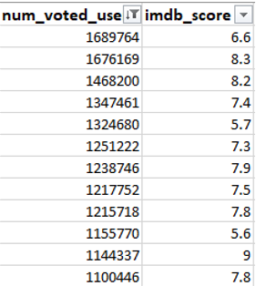
Numbers of users who voted for the movies and their impact on IMDB scores
Here is the list of number of users voted for movies along with their IMDB ratings filtered for top 20 values only.

Slide 17
Insight Gained:
From the bar chart plotted between number of users voted for the movies and the IMDB ratings of the movies, it is clear that even for the movie for which maximum number of users voted doesn’t have the highest IMDB ratings. This means that IMDB ratings of a movie does not depends on the number of users voted for it.

Slide 18
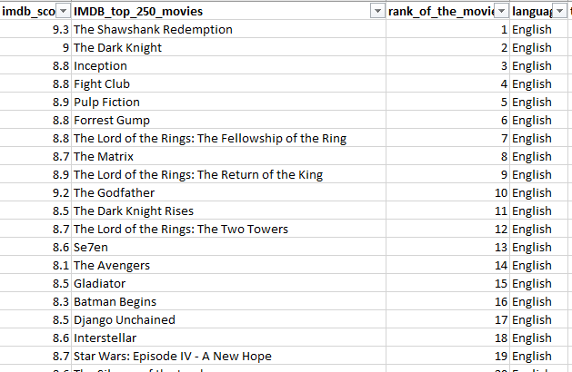
Top 250 movies and the movies which are in foreign language and their impact on IMDB scores
Here is the list of top 250 movies with their IMDB scores:

Slide 19
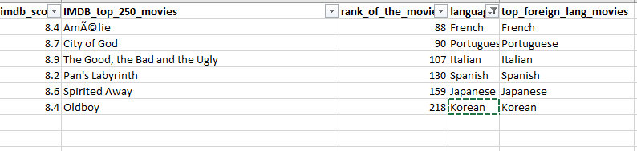
Here is the list of movies out of top 250 movies along with their IMDB scores for foreign languages (excluding English):

Slide 20
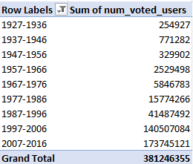
Number of voted users over the years

Slide 21

Favorite actors based on means of number of critic reviews and number of voted users
Below is the list of actors who has the highest mean of number of critic reviews and number of voted users:

Slide 22
Insight Gained:
After the analysis, it has been found that Leonardo DiCaprio is the actor who has the highest mean num_voted users and num_critic_for_reviews.

Slide 23
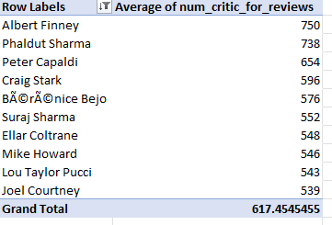
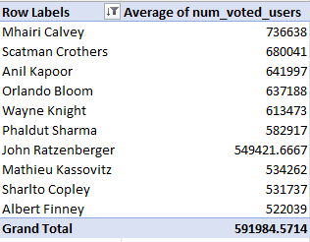
Mean of num_critic_for_reviews and num_voted_users for all actors

Slide 24
Insight Gained:
After analysis, it has been found that Albert Finney has the highest mean num_critic_for_reviews and Mhairi Calvery has the highest mean of num_voted_users.

Slide 25
Result
This project has helped me to level up my knowledge on descriptive analysis.
It has also helped me to achieve a better understanding of data cleaning by removing null, duplicate and missing values from the given dataset and organizing data.
It has also made me aware of the power of data visualization that is used to draw various insights from the real-world data.
It has improved my knowledge on how to do a RCA on a problem.

Slide 26
Drive Link
Google Drive Link For The Project

Slide 27
Thank You

